Slide 1
Reviewing Benchtop Tests from February 2nd 2023

Slide 2
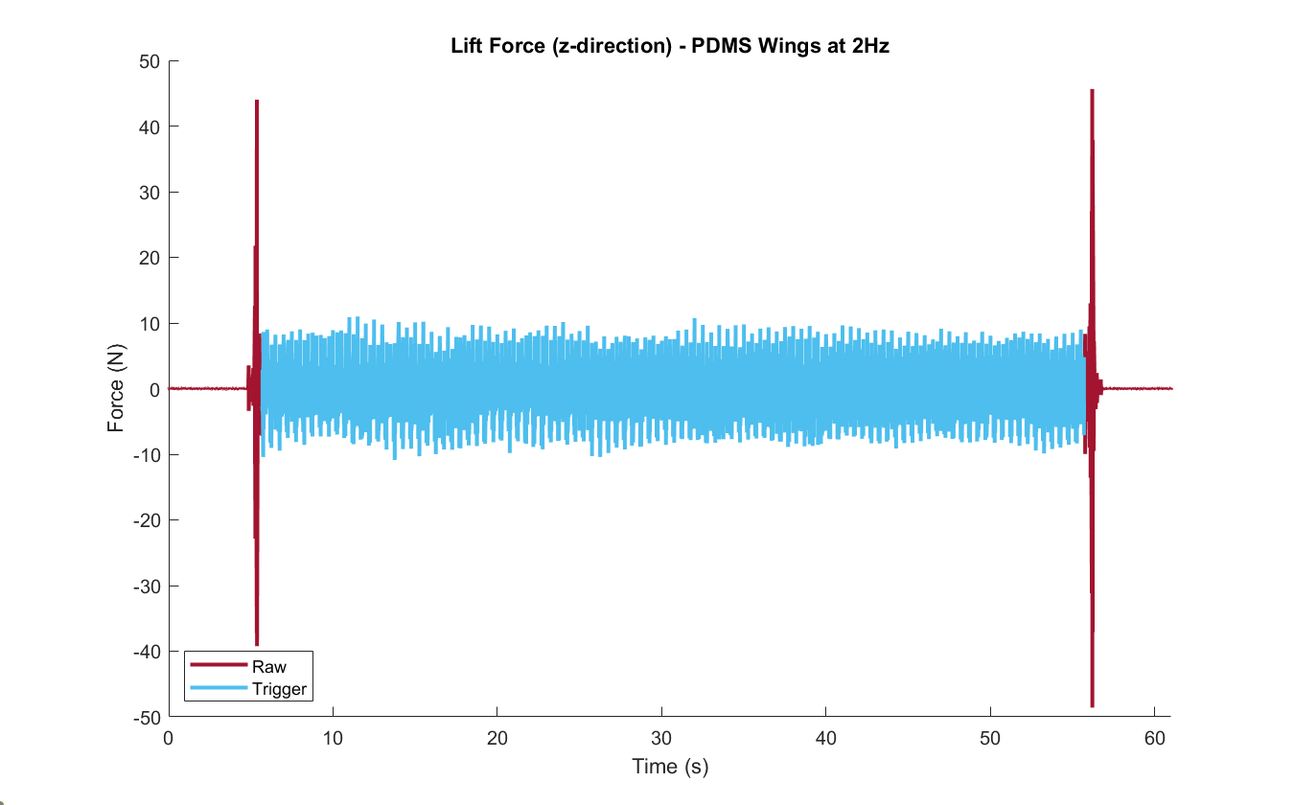
The beginning of the revolution after acceleration
The beginning of the revolution before deceleration

Slide 3
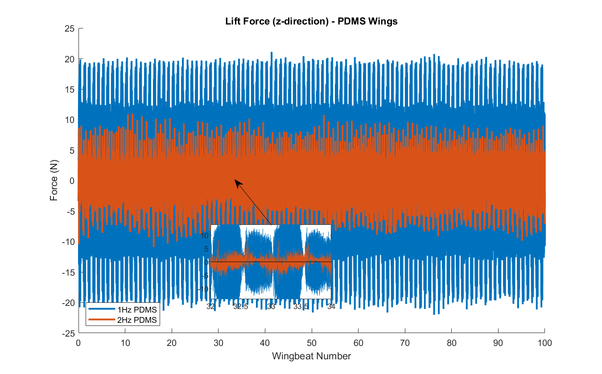

Slide 4
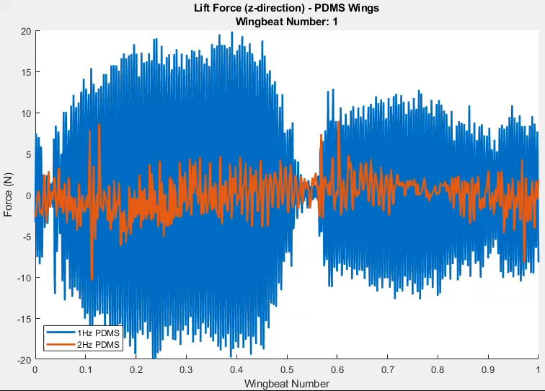

Slide 5
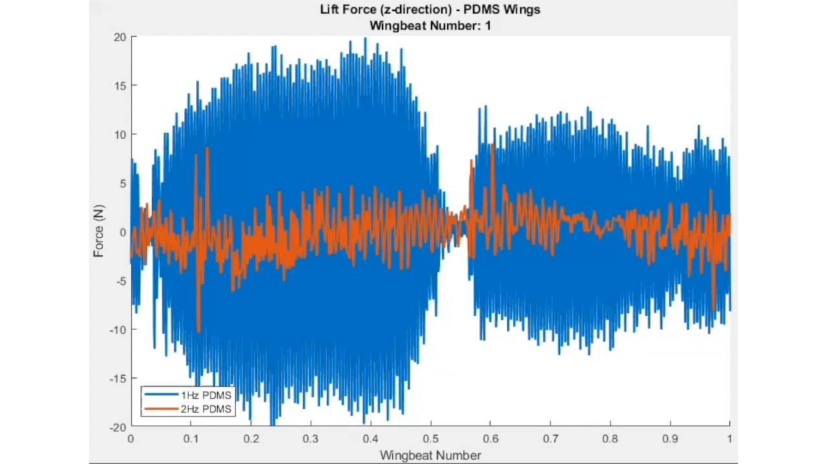

Slide 6
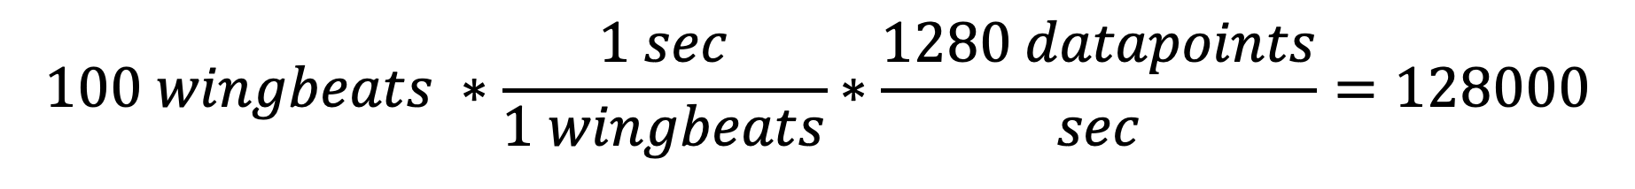
$$100 wingbeats ∗\frac{1 sec}{1 wingbeats}∗\frac{1280 datapoints}{sec}=128000$$
But instead we get 128018 or 128019.
Galil manual states:
"The accuracy of the trippoint is the speed multiplied by the sample period.”
Therefore, we expect extra frames counted to reduce with speed and number of wingbeat cycles.

Slide 7
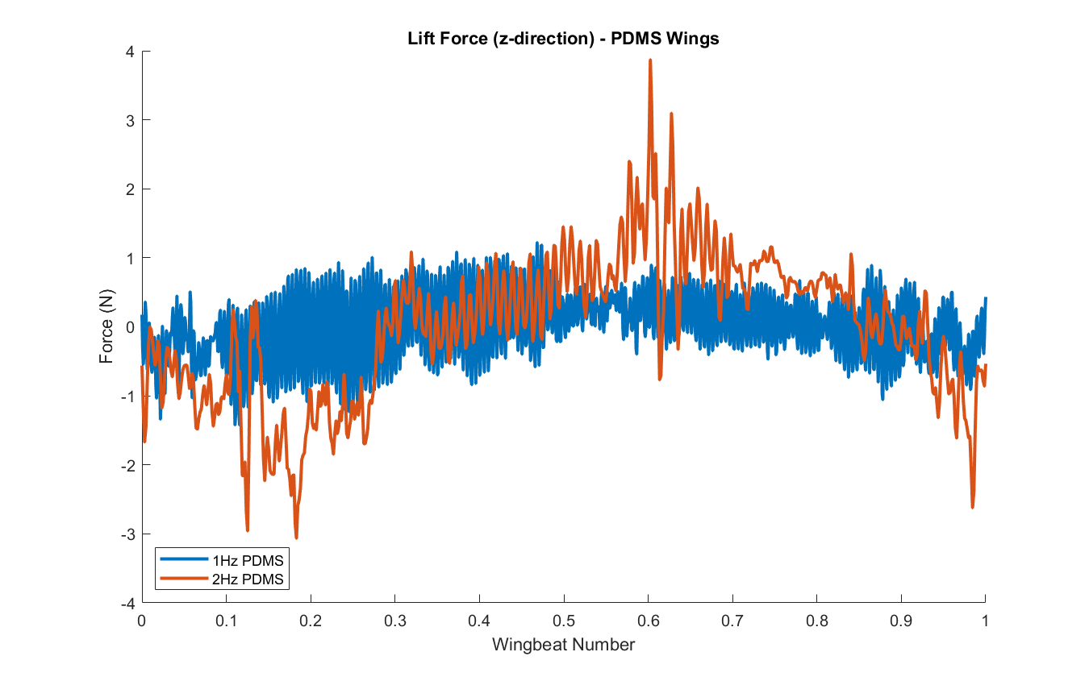

Slide 8
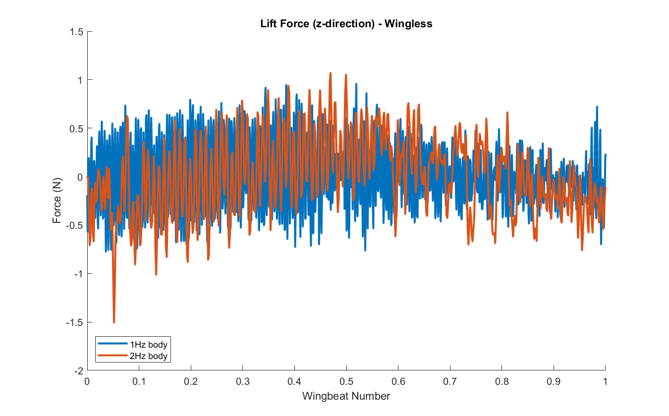

Slide 9
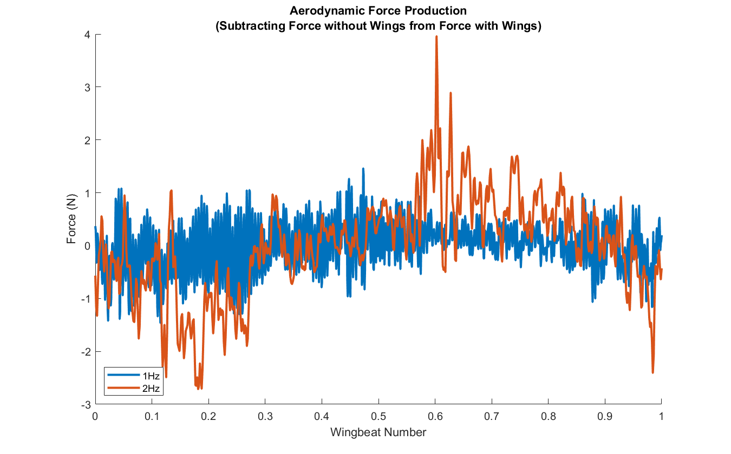

Slide 10
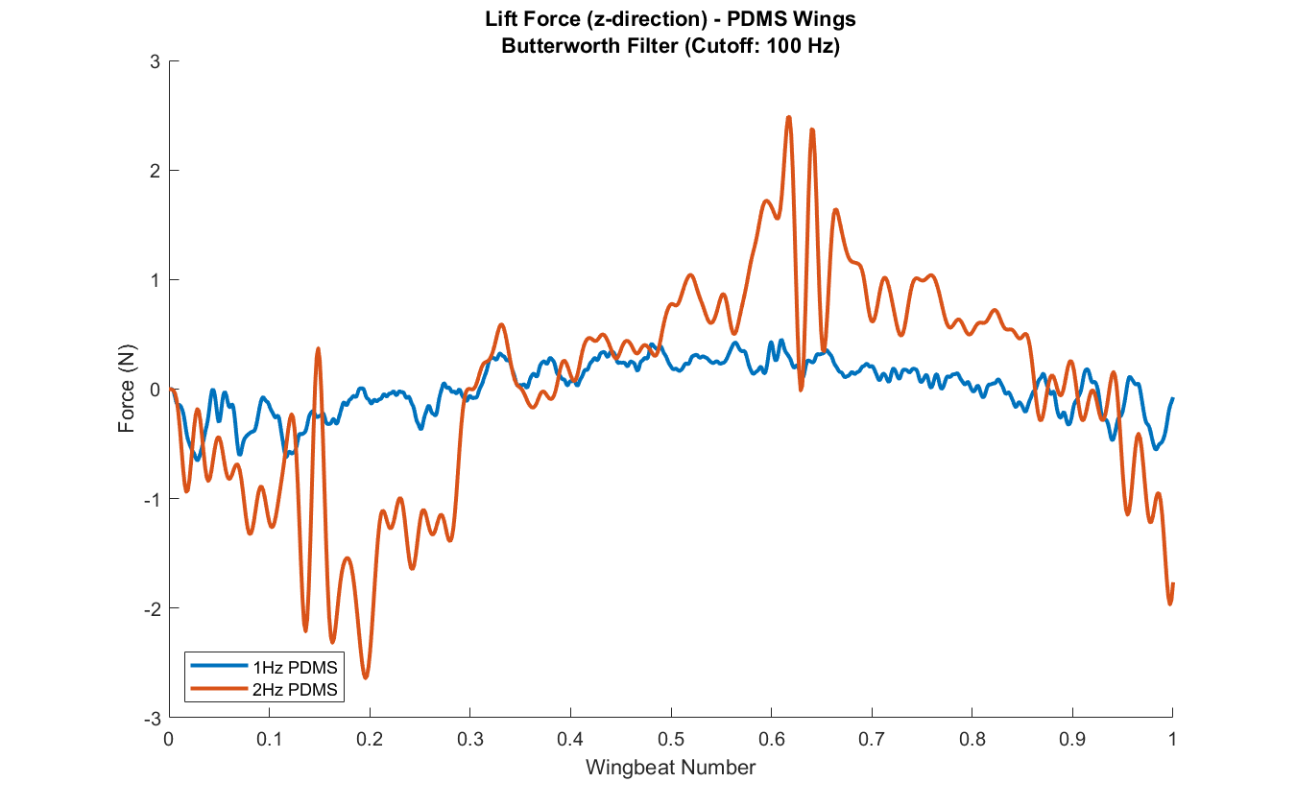

Slide 11
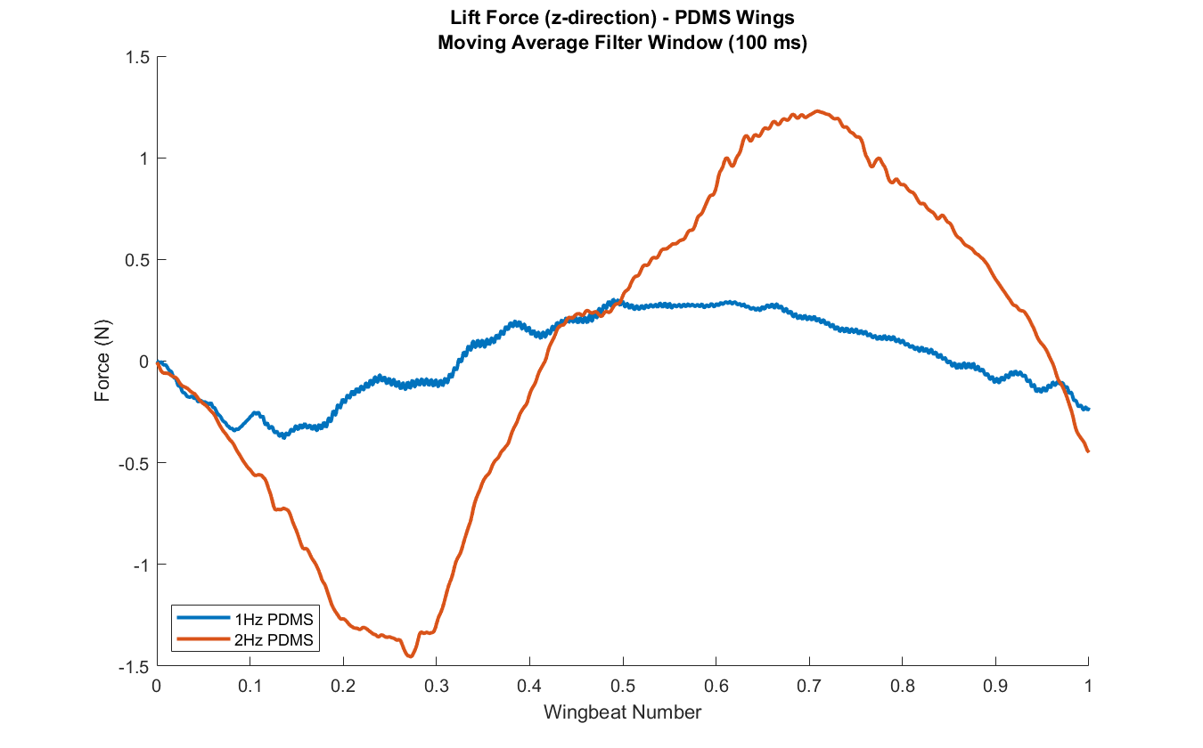

Slide 12
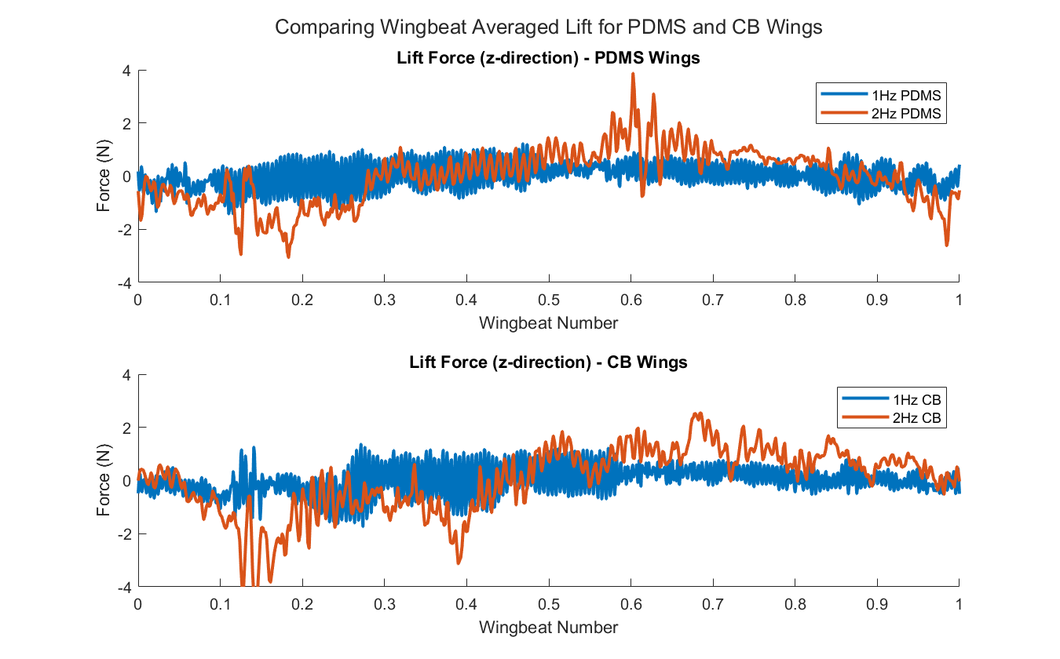

Slide 13
Revisions:
Increase the number of wingbeats sampled (100 -> 600)
Extend the delay after acceleration (and before deceleration) before activating the trigger
Manually move stepper such that the beginning of the revolution is roughly at the beginning of upstroke
Reconstruct flapping mechanism to include new gearbox

